Slide 1


Weeky Collaborative Weekly Scheduler
Haipeng Wang
Haoyin Zheng
April 25, 2025

Slide 2

Project Overview
Purpose:
To help small teams or friend groups easily coordinate weekly availability through a shared visual scheduler.
Users:
Anyone who needs to coordinate time availability within a small group
Expected Outcome:
Users share a link → choose time slots → System demonstrates common times using heatmap/ratiomap.

Slide 3
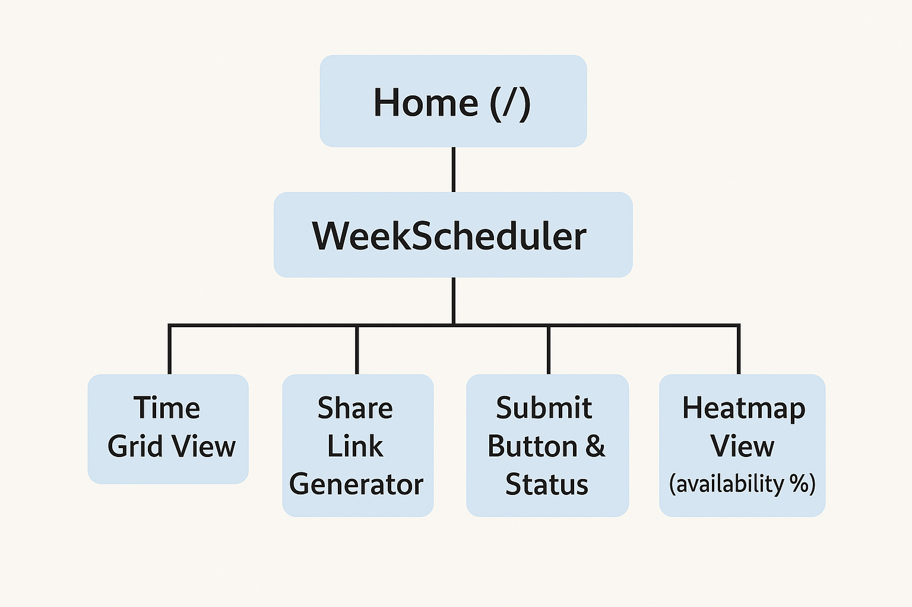
Sitemap & Page Roles

Slide 4
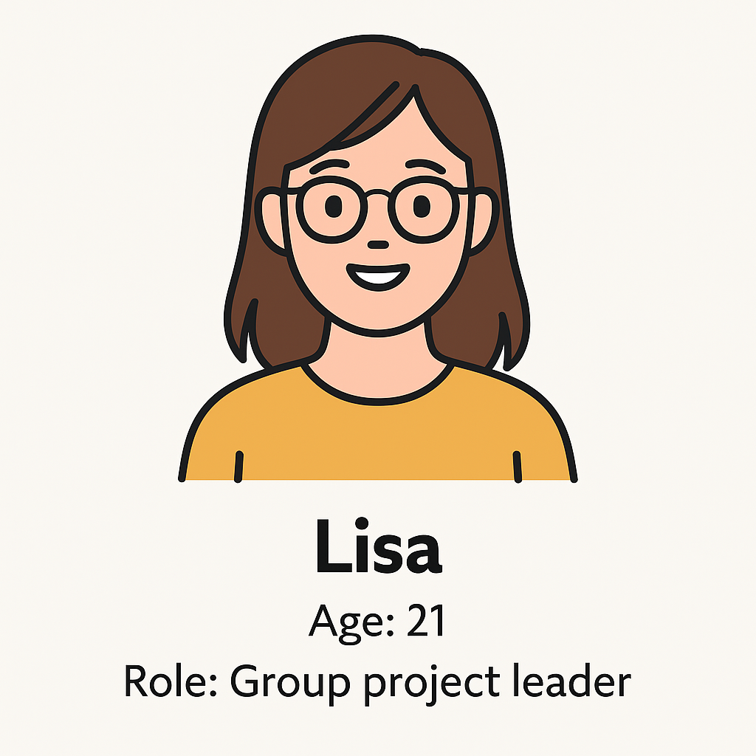
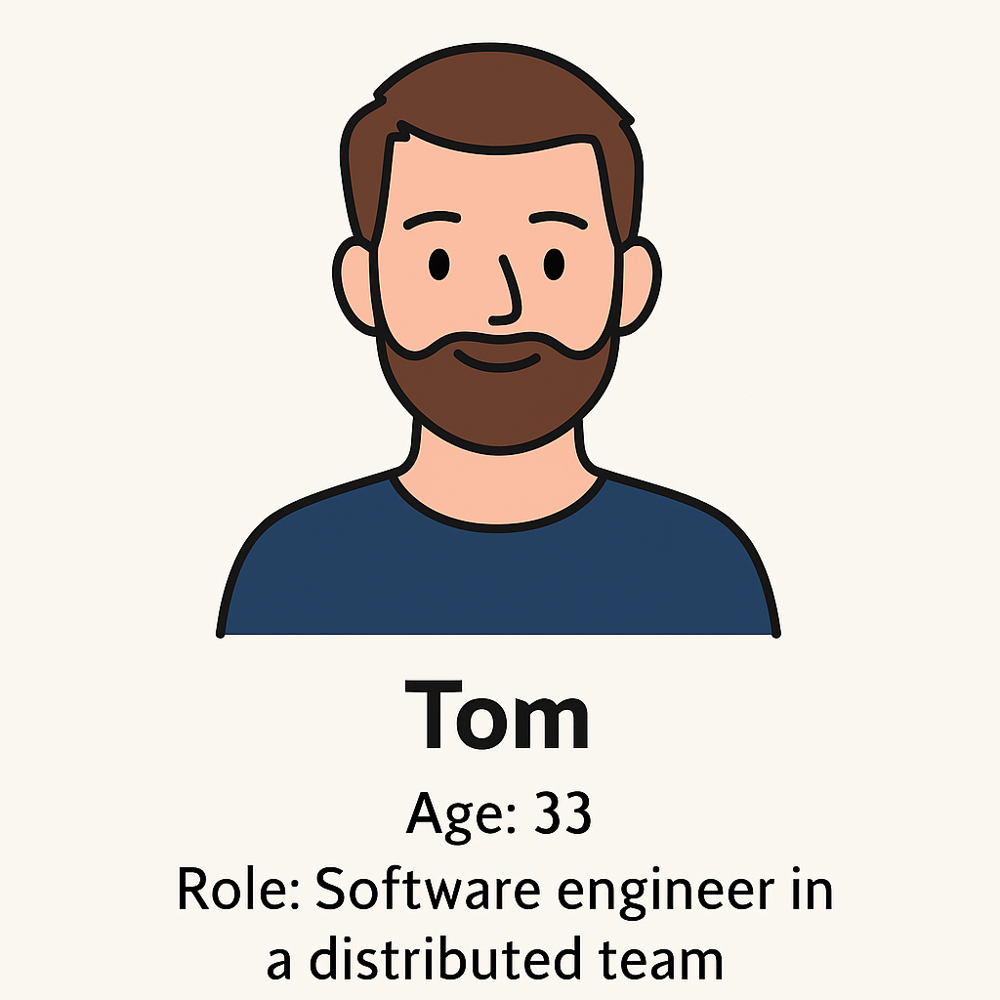
Persona Analysis
Age: 21
Role: Group project leader
Goal: Coordinate everyone's free time quickly
Frustrations: Constantly asking "When are you free?" in group chats
Needs: Simple tool with clear visual time overlap
Age: 33
Role: Software engineer in a distributed team
Goal: Schedule daily standups Frustrations: Misaligned calendars and email clutter
Needs: Fast overview of who’s available and when

Slide 5
User Journey – Lisa
Lisa opens a shared Weeky link to coordinate a group project.
She is free for the whole week, but she has to clicks each available time slot one by one.
After submitting, she sees no visual clue of which time slots are more popular.
Opportunities Discovered:
“Select All” improves efficiency for users with broad availability
“Heatmap” view allows users to intuitively see the best group time slots

Slide 6
User Journey – Tom
Tom had submitted his weekly availability.
On Monday, his work schedule suddenly changes.
He tries to manually unselect each old slot before submitting again.
Opportunities Discovered:
Users need a quick “Clear” button
“Resubmit” updated availability is needed

Slide 7
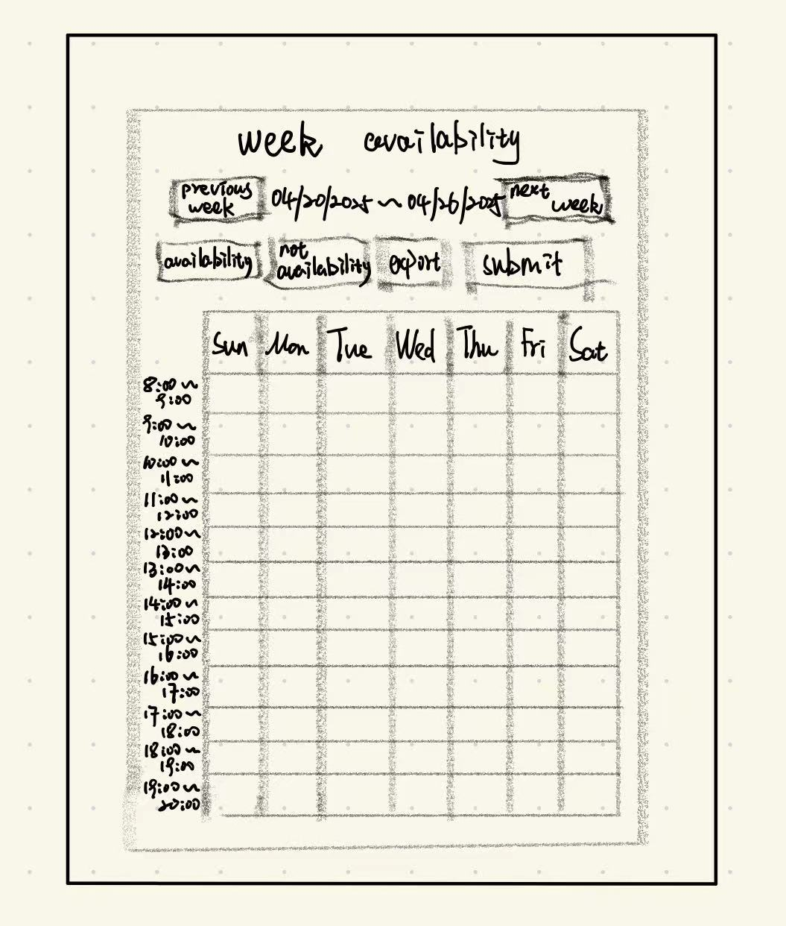
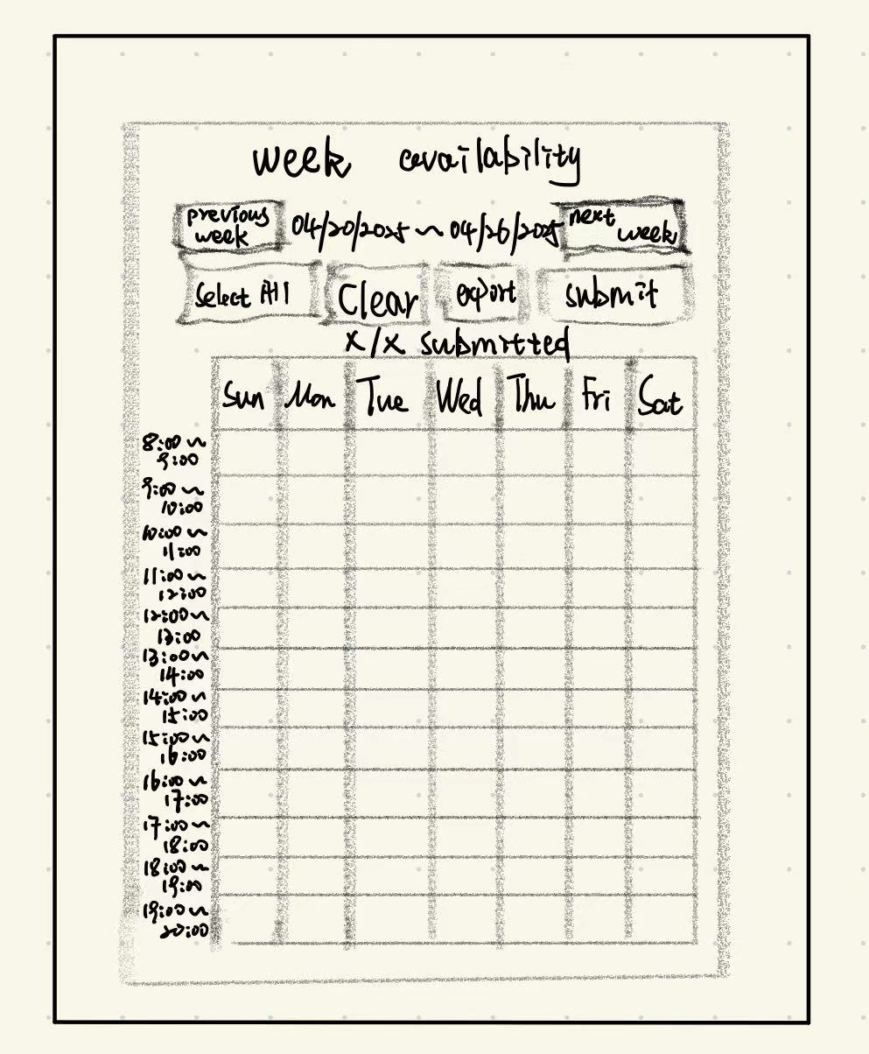
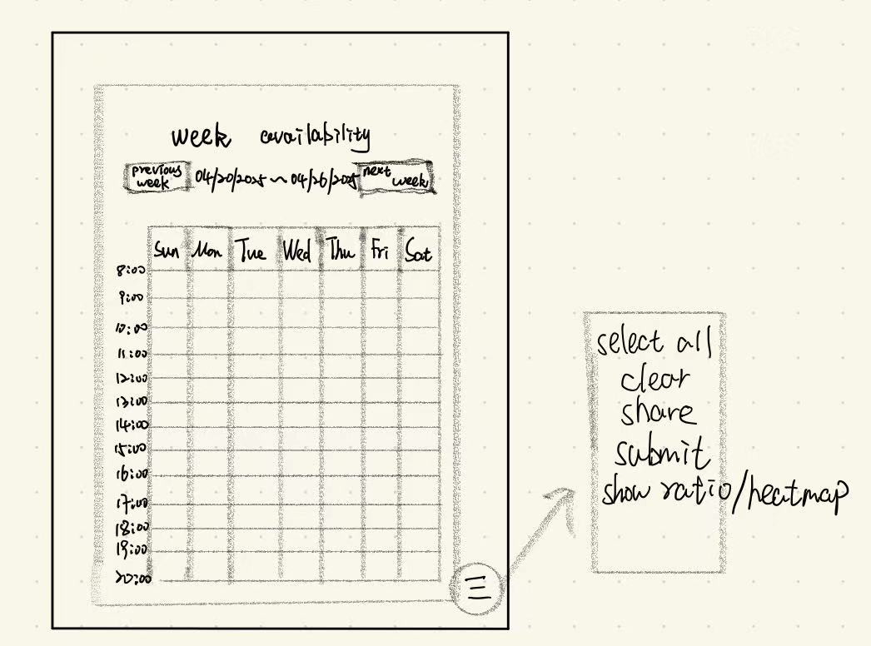
Low-Resolution Mockups

Slide 8
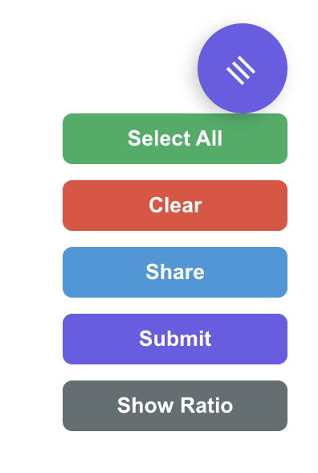

Colors
Purple:
Primary actions - Highlights major interaction majors.
Red:
Clear button - Caution of deletion.
Green:
Select all - Confirmation/positive action
Blue:
Share link – Connection
Heatmap Gradient：
Indicate time slot overlap intensity

Slide 9
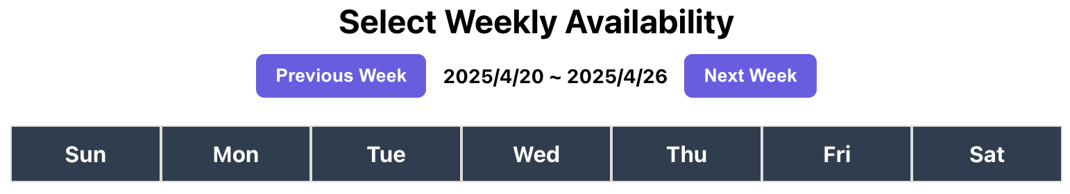
Typography
Modern，sans-serif
It gives a clean look, optimized for screen.

Slide 10
Future Plans & Learnings
Future:
Add calendar export (Google Calendar sync)
Mobile-first UX improvements
More DIY options(title, time slot)
Team Learnings:
Usability First
Simulated User Interaction
Sense of Confirmation

Slide 11
Thank you!!!!!!

